Slide 1
Research Methods in Climate Science
Lecturer:
Babatunde J. Abiodun
Department of Environmental and Geographical Science
University of Cape Town
South Africa

Slide 2
Research: Think, Analyse, and Write
The purpose of this course motivate you to:
Think: a series of lecture/discussions on
conceptualization of creative and original research topic
proposal writing
research plan, design and implementation
Analyse: the nuts and bolts of quantitative analysis
The quantitative analysis sessions
not a basic statistics course
The primary objective is data manipulations, decomposition and interpretations
The techniques investigated are (mostly) the fundamental methods found commonly in the literature.
Write: the basic rules of academic writing and research
Conscious critical reading and writing skills
read academic texts with greater insight and apply these to your writing

Slide 3
Course Contents: Analysis section
The content will include:
Data Classification
Cluster analysis
Principal Component Analysis (PCA)
Self Organizing Maps
Time series
Trend Analysis and Detrending
Auto-correlation Analysis
Fourier Analysis
Wavelet Analysis
The Grand Challenge

Slide 4
Data Classification and Cluster Analysis
Babatunde J. Abiodun
babiodun@csag.uct.ac.za

Slide 5
Data Classification

Slide 6
Data Classification
Generalize data into groups of similar type, to reduce the data size.
Objective:
To identify groups in parameter space
User specifiable measure of similarity
Place boundaries through the space
Ideal solution: minimize within group variance and maximize between group variance.

Slide 7
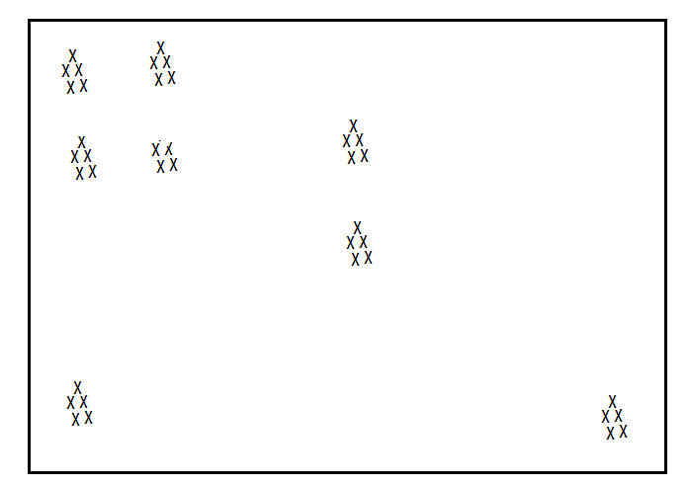
Example (1)

Slide 8
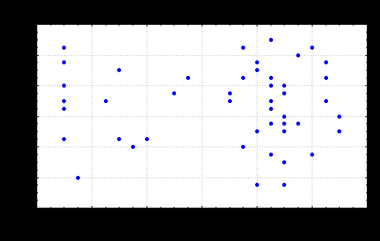
Example(2)
The data may be grouped by drawing boundaries between clusters...
some data points may be poor fits...
some may be outliers...
the positioning of the boundaries is subjective...

Slide 9
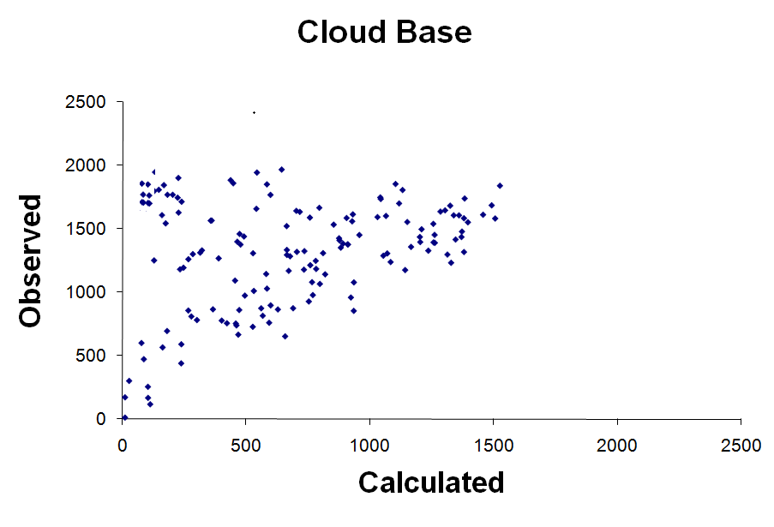
Example (3)
Notes:
Story behind the Figure:
This is a student project looking at the correlation between observed and calculated cloud base height.
He found the data along the linear path (will correlated ) are most the data obtained during the daytime, while of the uncorrelated data are those obtained at nighttime or under strong wind conditions.

Slide 10
Main Issues...
looking for general groups
identifying outliers
accuracy <--> number of clusters

Slide 11
Multiple procedures available... Which is right?
The "right" procedure is the one that aids your interpretation i.e. give insight into what is in the data.
Any classification method is subjective
Ideal solution depends on user specification of algorithm, measure of similarity, etc.
Know your data!
Manual classification (given manageable data volumes) is often as good as anything else. [See journal paper by Key and Crane (1986)].
Key J, Crane RG. (1986): A comparison of synoptic classification schemes based on ‘objective’ procedures. Journal of Climatology 6: 375–388.

Slide 12
Objective procedures
Automated clustering is rule based. Data points are "joined" based on some measure of distance (e.g.: Euclidian distance).
Note: Assumption of orthogonality: What are the implications.... !!!!!!!!!!!!!

Slide 13
Cluster Analysis

Slide 14
Cluster Analysis
There are numerous algorithms to undertake clustering, but fall into two basic categories: -
Clustering where the number of groups are defined by the user after the procedure
Clustering where the user pre-defines the number of groups
We will focus on the first option
single linkage,
average linkage
Wards algorithm

Slide 15
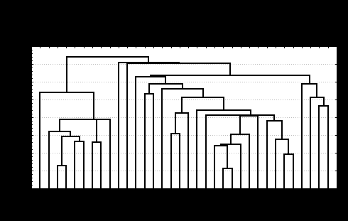
Single linkage
Single linkage: - start with the two closest points and link - find next two closest and link - find next two ..... . - until all data points are linked
On completion one can generate a cluster tree, whereby the linkage between data points is graphically shown as a function of the distance between the points:
Note single linkage problem: leads to chaining ..... the "next closest point" is determined by measuring unclustered points against all points in a cluster.....
With a cluster tree, first decision: Where to cut the tree.....
look for jumps in the distances between joins....
Thus: single linkage tends to identify outliers....
Linkage distance
Points

Slide 16
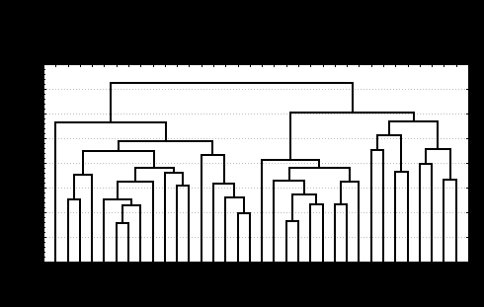
Average linkage
A better routine to find groups is to use the centroid or mean of a cluster when measuring new points.
Start clustering as before, but for any group of data points, represent these by a single point with a value calculated as the centroid of all points in the group.
Thus:
Outliers still identified
Groups here are better defined, but clear breaks in groups still not very clear.
Linkage distance
Points

Slide 17
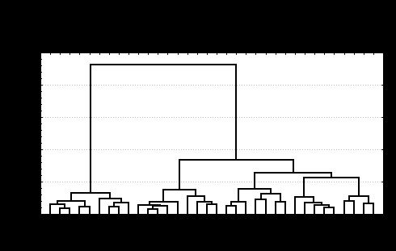
Wards algorithm
Another procedure is Wards, based on analysis of variance.
This seeks to minimise within group variance and maximise between group variance.
Data points are joined to a particular group on a basis of whether their addition to this group improves the within group variance more than addition to some other group.
Thus:
Groups are well defined, of more equal size.
Outliers are not well identified
Linkage distance
Points

Slide 18
Practical Using Statistical or other software
Notes: - In your data matrix, you may cluster rows or columns -- this influences the dimensionality of your data space - Choice of algorithm is subjective and influences the result - Euclidian distances which assume orthogonality are generally used - Other more sophisticated non-linear techniques will be explored later.

Slide 19
Principal Component Analysis

Slide 20
PCA: Aliases
Eigenvector Analysis
Factor Analysis
Empirical Orthogonal Function (EOF)

Slide 21
PCA: What is it?
A procedure to ....
extract fewer and independent underlying dimensions around which the data variance is organised -- the "real" or pseudo-variables (components)
express the original variables in their relation to these components
re-express the original data as if measured in terms of these components.

Slide 22
Example (1)PCA (Old data vs New data)
Headache
FP2
Temperature
FP1 (Fever!)

Slide 23
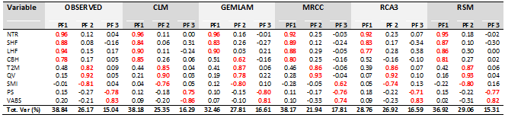
PCA (2): Example

Slide 24
Talk about….
Background mathematical concepts
Statistics
Matrix algebra
Principal Component Analysis (PCA)

Slide 25
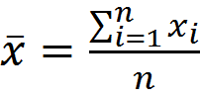
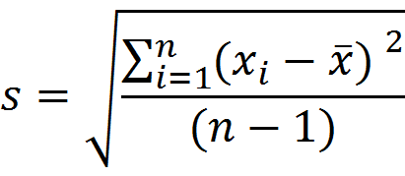
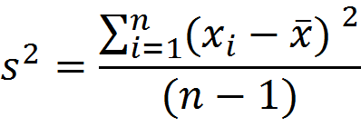
Basic mathematical concepts (1): Statistics
Mean:
Standard Deviation:
Variance:

Slide 26
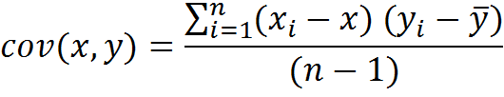
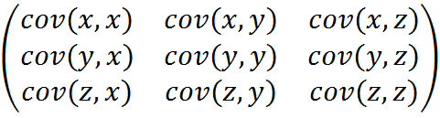
Basic mathematical concepts (1): Statistics
Covariance:
Covariance Matrix:
C(x,y,z) =

Slide 27
Basic Mathematical concept (2): Matrix Algebra
Eigenvector: Given a matrix, an eigenvector of that matrix is a nonzero vector which, when the matrix is multiplied with, may change in length, but not direction.
Eigenvalue: For each eigenvector, there is a corresponding eigenvalue, which is a scalar value that determines the amount the eigenvector is scaled when multiplied with the matrix.

Slide 28
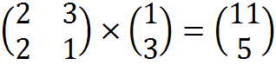
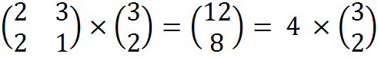
Basic Mathematical concept (2): Example of Eigenvector and eigenvalue
Hence:
is not an eigenvector of
is an eigenvector of
with is an eigenvalue of 4

Slide 29
Properties of eigenvectors
Can only be found for a square matrix
n x n marix, that has eigenvectors, will have n of them.
Eigenvectors are perpendicular (i.e. orthogonal)
Use eigenvectors of that have a unit length.

Slide 30
Principal Component Analysis
Method (6 steps)
PCA with Statistical

Slide 31
PCA Method: Step 1
Get some data
Temperature | Headache
4 | 5
2 | 4
-3 | -2
-5 | -3
2 | 1
-1 | 1
3 | 3
-2 | 0
5 | 4
Headache
Temperature

Slide 32
PCA Method: Step 2
Standardize the data (i.e. subtract the mean)
Temperature | Headache
3.44 | 3.56
1.44 | 2.56
-3.56 | -3.44
-5.56 | -4.44
1.44 | -0.44
-1.56 | -0.44
2.44 | 1.56
-2.56 | -1.44
4.44 | 2.56
Headache
Temperature

Slide 33
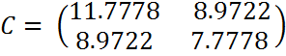
PCA Method: Step 3
Calculate the covariance matrix
 | Temperature | Headache
Temperature | 11.7778 | 8.9722
Headache | 8.9722 | 7.7778

Slide 34
PCA Method: Step 4
Calculate the eigenvector and eigenvalues of the covariance matrix
0.7071 | 0.7071
0.7071 | -0.7071
Eigenvectors =
Headache
1.9374
0.0626
Eigenvalues =
Temperature

Slide 35
PCA Method: Step 5
Choose components and forming a feature vector.
1.9374
0.0626
1.9374
Eigenvalues =
OR
0.7071
0.7071
0.7071 | 0.7071
0.7071 | -0.7071
Feature vector =

Slide 36
Loadings
 | PF1 | PF2
Temperature | 0.7071 | 0.7071
Headache | 0.7071 | -0.7071
1.9374
0.0626
Eigenvalues =

Slide 37
PCA Method: Step 6
Deriving the new data set
FinalDataSet = FeatureVector (transposed) x AdjustedDataSet (transposed)
e.g.:
FP1 | FP2
4.95 | -0.08
2.83 | -0.79
-4.95 | -0.08
-7.07 | -0.79
0.71 | 1.33
-1.41 | -0.79
2.83 | 0.62
-2.83 | -0.79
4.95 | 1.33
0.7071 | 0.7071
0.7071 | -0.7071
Temp | 3.44 | 1.44 | -3.56 | -5.56 | 1.44 | -1.56 | 2.44 | -2.56 | 4.44
Headache | 3.56 | 2.56 | -3.44 | -4.44 | -0.44 | -0.44 | 1.56 | -1.44 | 2.56
=
x

Slide 38
PCA (Old data vs New data)
FP2
Headache
Temperature
FP1 (fever!)

Slide 39
Some Applications

Slide 40
PCA Part 2: Some Applications

Slide 41


Slide 42
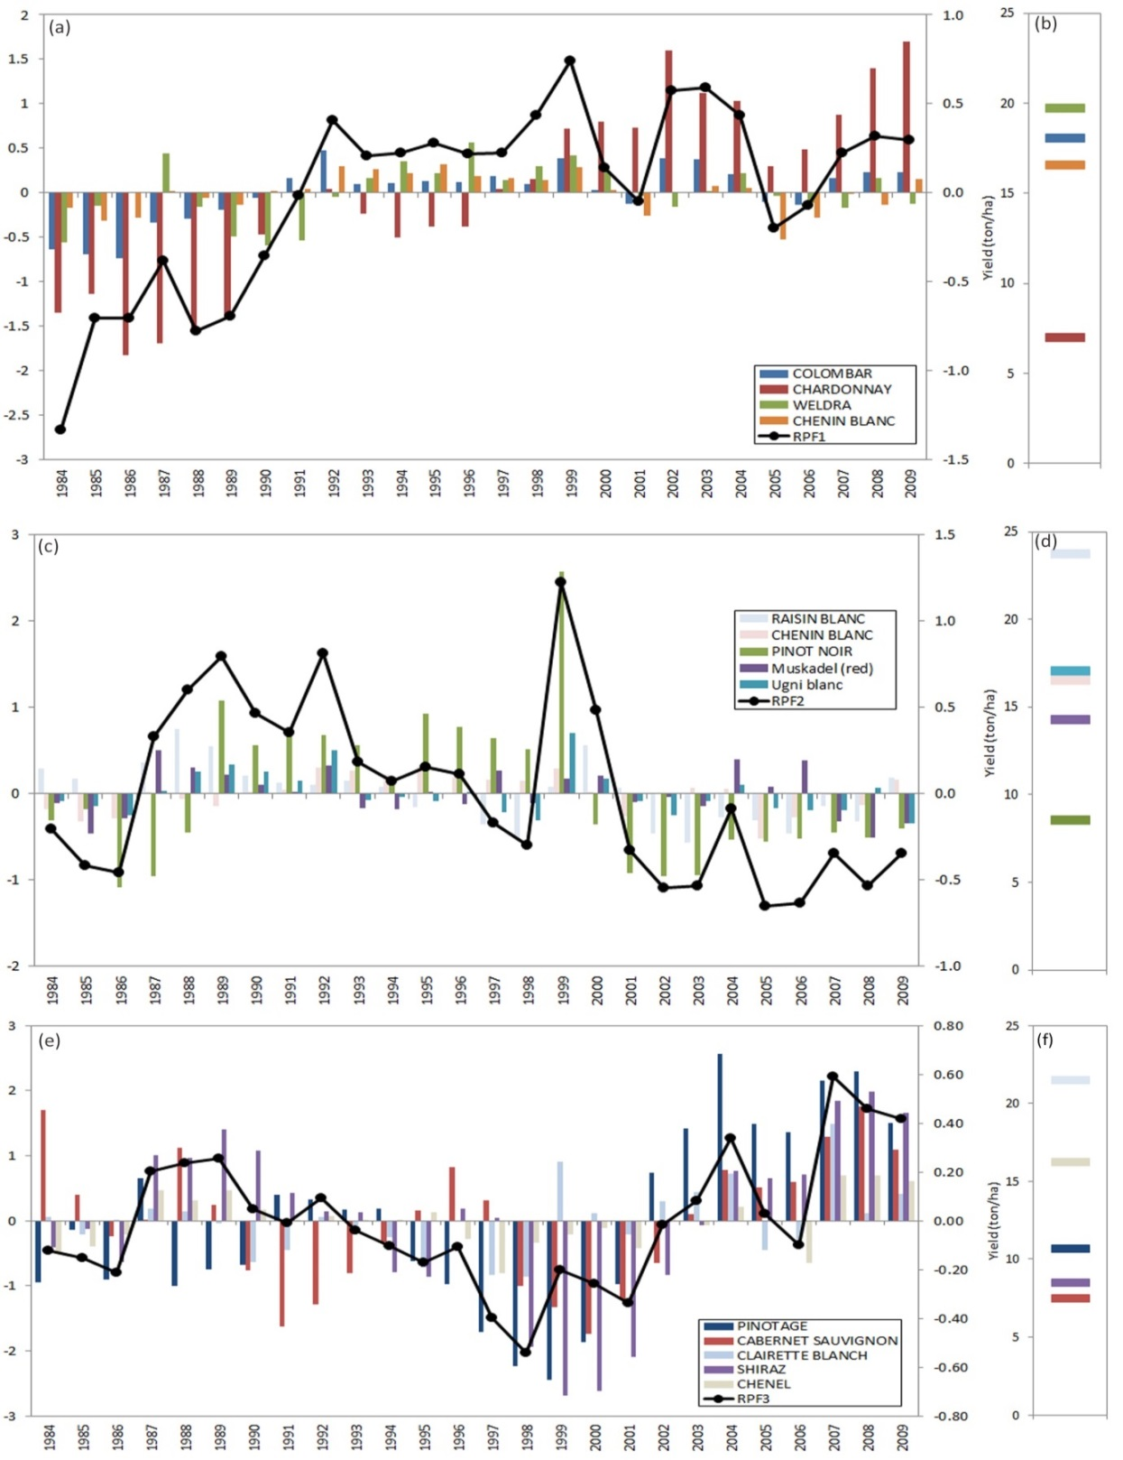
Yield Groups
Robertson
PCA jointly explains 62% of variance in the data

Slide 43
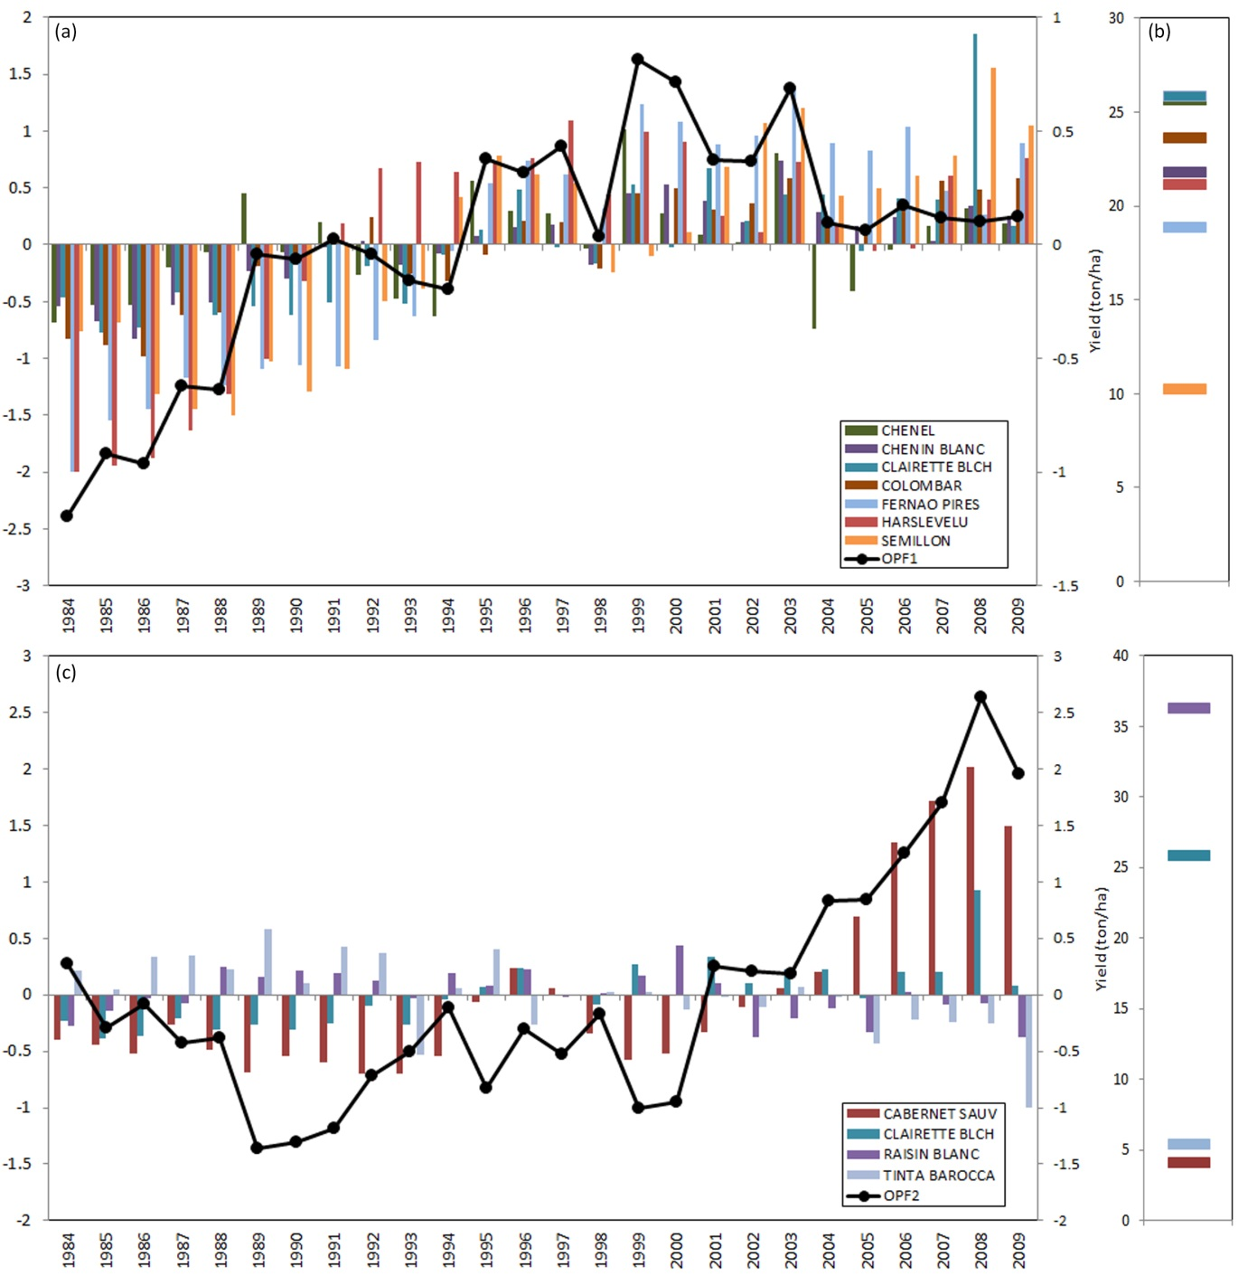
Olifants River
PCA jointly explains 83% of variance in the data

Slide 44
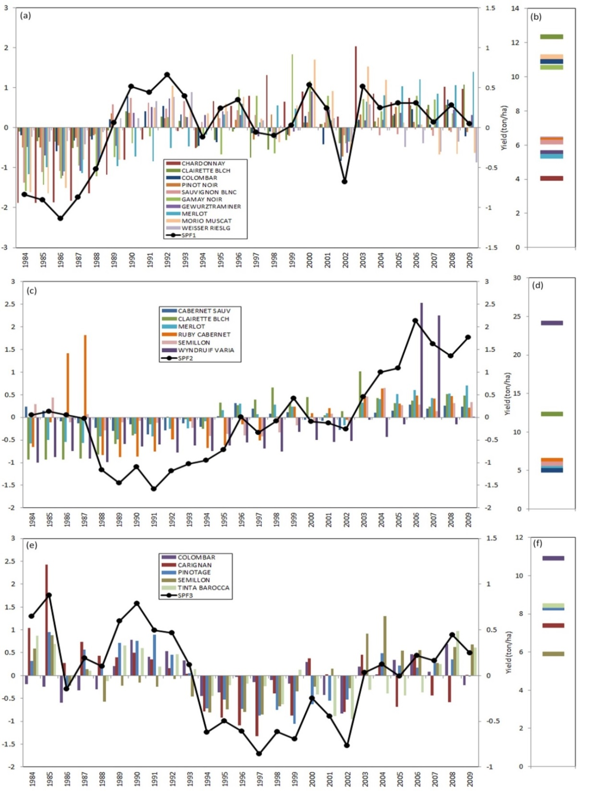
Stellenbosch
PCA jointly explains 72% of variance in the data

Slide 45
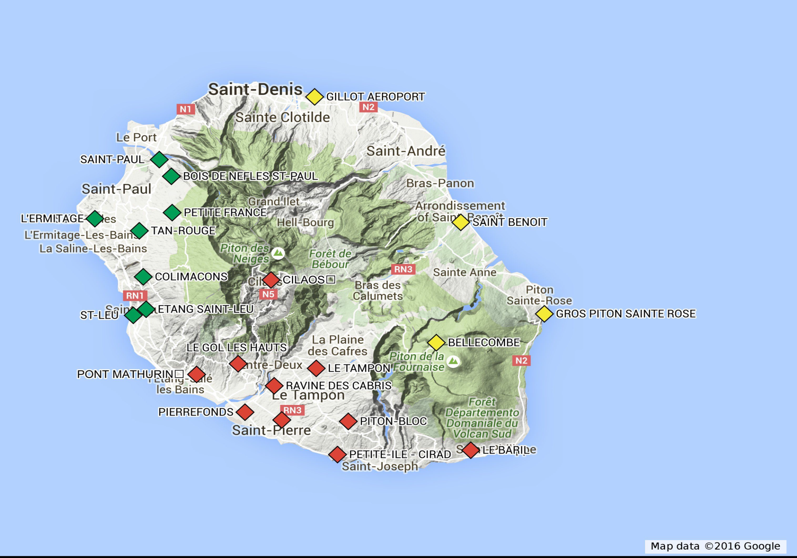
Re-union Island (Solar Radiation)

Slide 46
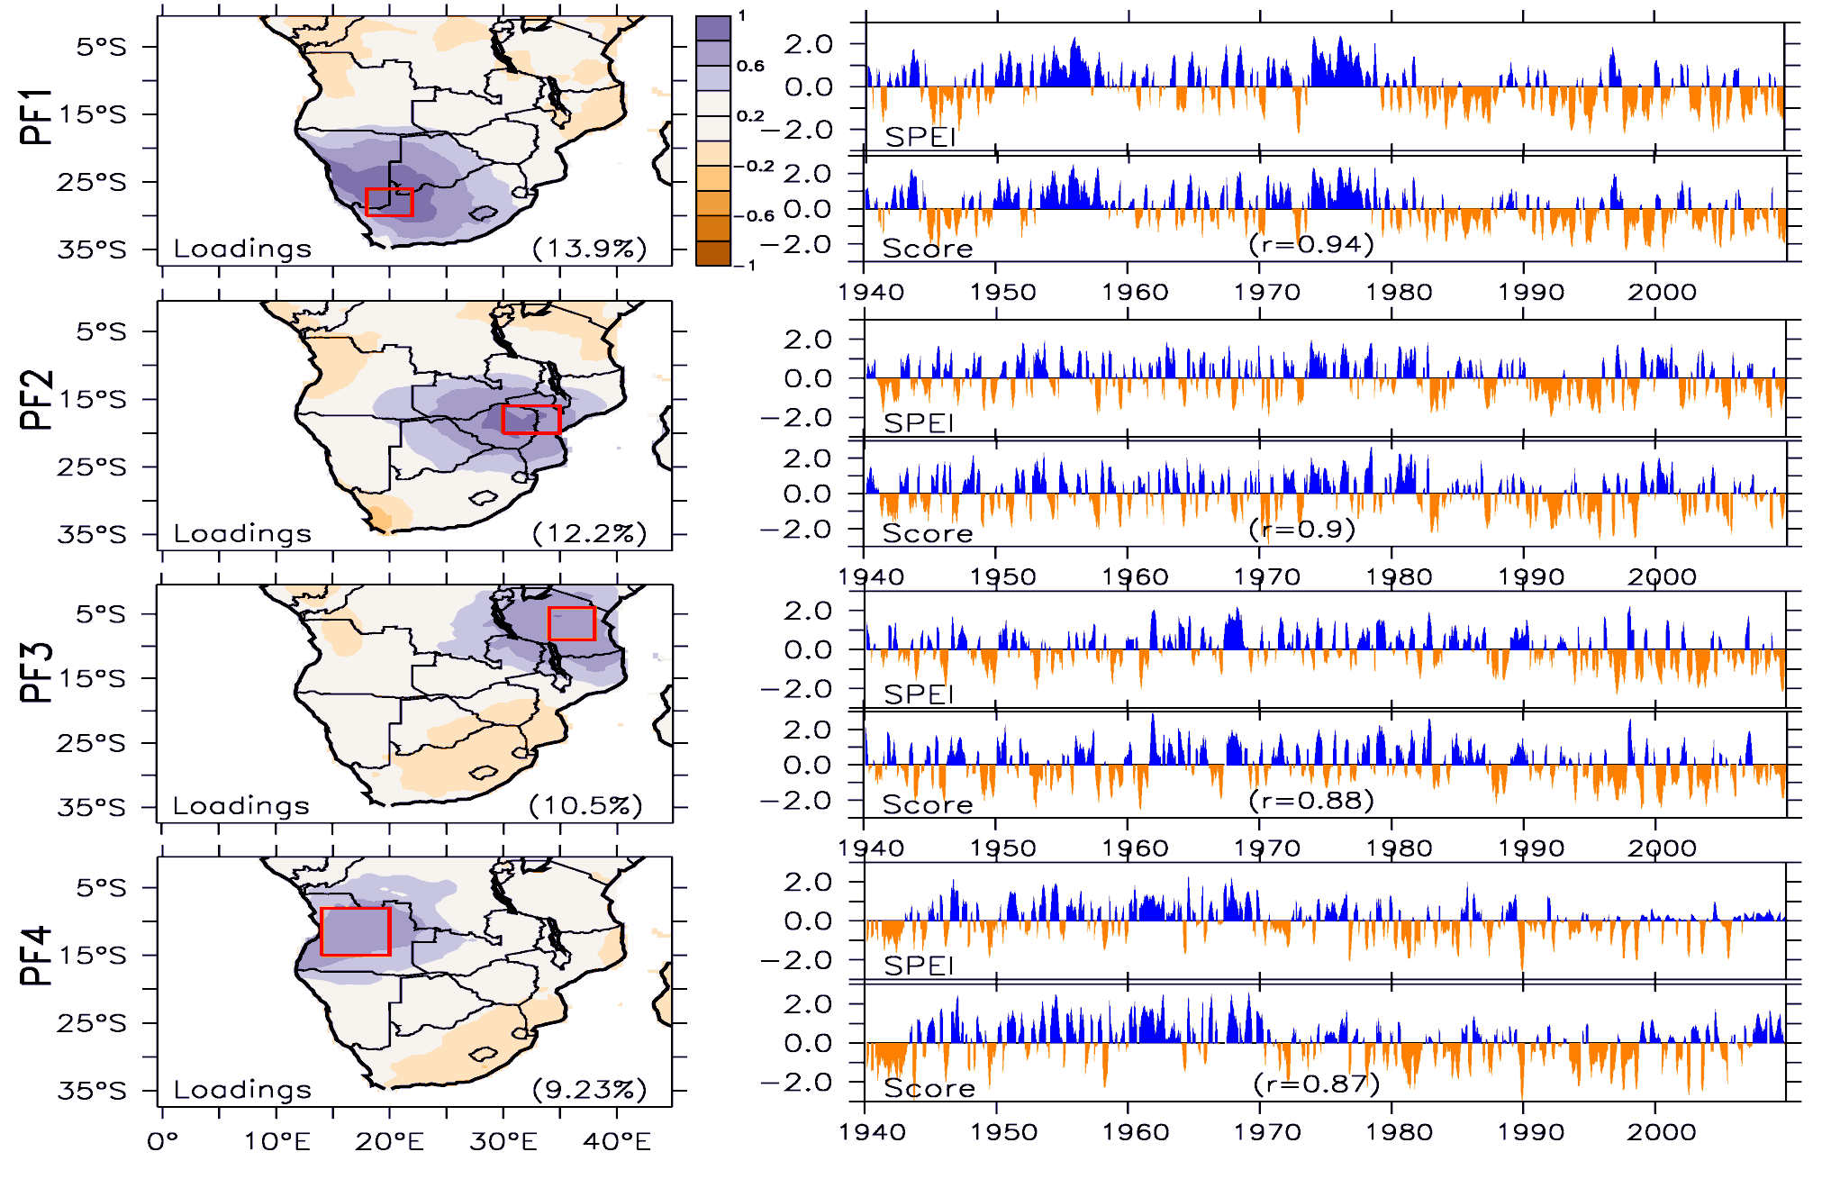
Drought Modes
Ujeneza and Abiodun (2015)

Slide 47
Practical Using Stastistical or other software
Notes: - In your data matrix, you may cluster rows or columns -- this influences the dimensionality of your data space - Choice of algorithm is subjective and influences the result - Euclidian distances which assume orthogonality are generally used - Other more sophisticated non-linear techniques will be explored later.

Slide 48
Self-Organizing Maps

Slide 49
What is a Self-Organizing Map?
A Self-Organizing Maps (SOM) is a form of Artificial Neural Network(ANN)
It uses unsupervised learning
It used for data clustering, visualization and dimensionality reduction
It takes a high dimensional data as input and reduces it to a low-dimensional (typically two-dimensional) input space of training samples called maps.

Slide 50

What is an Artificial Neural Network

Slide 51
Self-Organising Maps
Invented by Teuvo Kohonen.
Unsupervised ANN using competitive learning.
Provide mechanism for visualising complex relationships in multi-dimensional data sets.
A tool used for clustering, visualisation and dimension reduction.
“Given an N-dimensional cloud of data points, the SOM will seek to place an arbitrary number of nodes within the data space such that the distribution of nodes is representative of the multi-dimensional distribution function, with the nodes being more closely spaced in regions of high data densities”

Slide 52
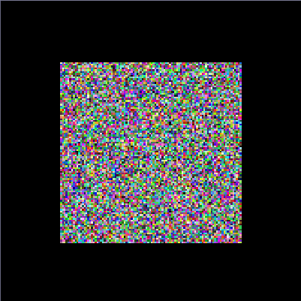

SOM Classification of Colour points
Randomly initialized map
Map trained on shades of red, green, and blue

Slide 53
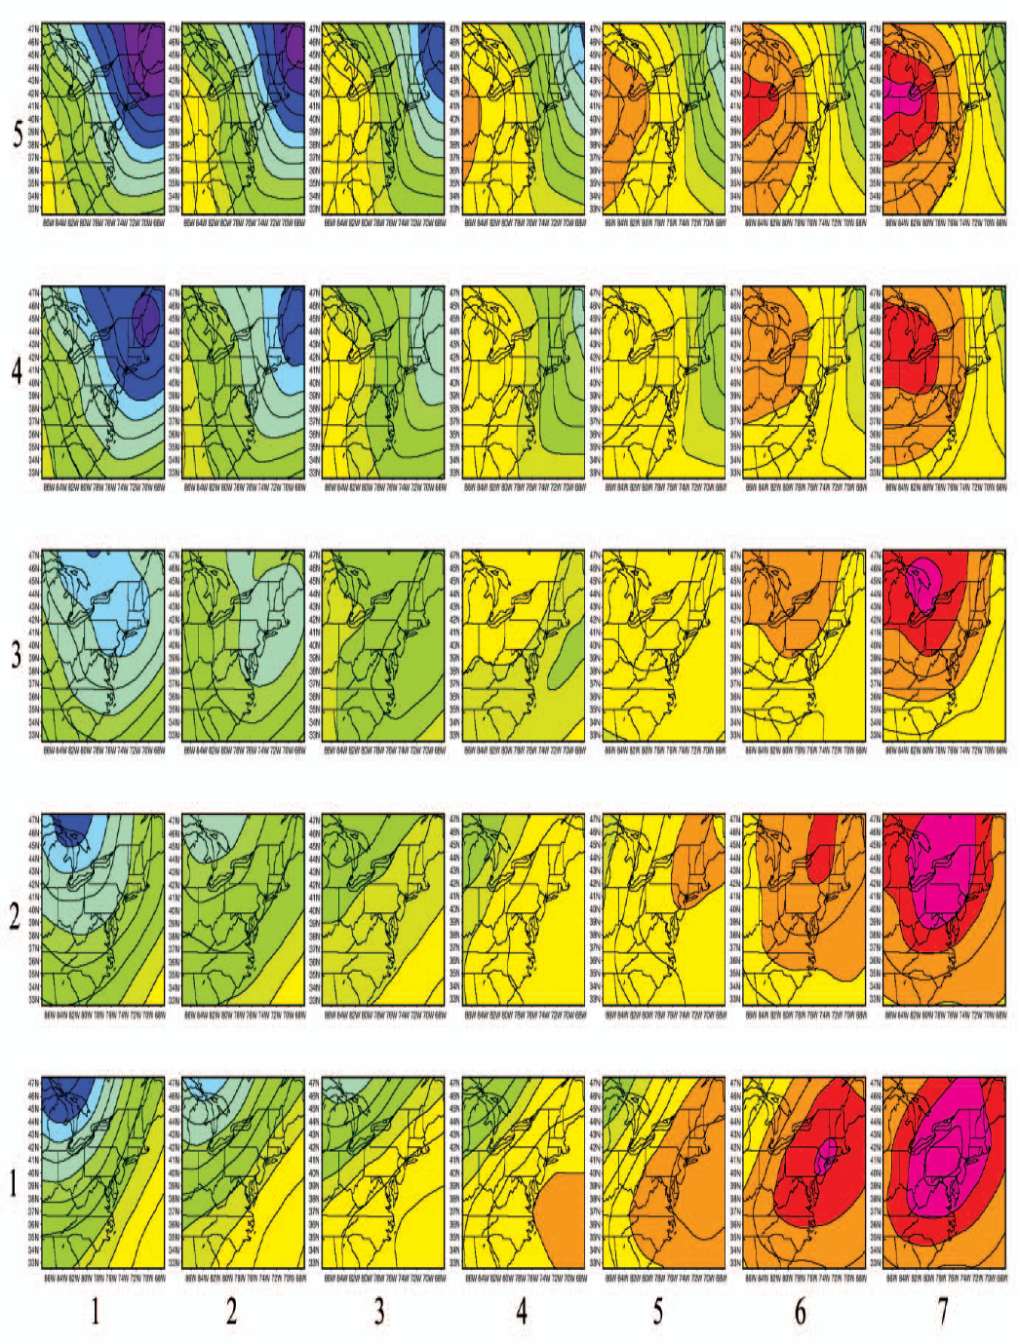
Example 1: 5x7 SOM array of Jan SLP for NE USA (Hewitson and Crane, 2002)
Notes:
identify the primary features of the synoptic-scale circulation over the region. In effect, the nodes represent a non-linear distribution of overlapping,non-discreet, circulation types. The circulation patterns are readily visualized in a 2-dimensional array (the SOM) that places similar types adjacent to one another and very different types far apart in the SOM space

Slide 54
Evaluation of the SOM Training
Evaluation of the quantization error
A list of the coordinates corresponding to the best-matched unit in the map for each data sample in the data file is produced. This list file also gives the individual quantization error for each sample.
Sammon Map
Generates the Sammon mapping from n-dimensional input vectors to 2-dimensional points on a plane whereby the distance between the image vectors tend to approximate the Euclidean distances of the input vectors.
(Hewitson and Crane, 2002)
(Hewitson and Crane, 2002)

Slide 55
Climatological 40 yr mean frequency (%) of days in a month mapping to each SOM node. eg. The frequency of Node 1:2 is 1.56 % and corresponds to this SLP pattern.
Frequency of Occurrence
(Hewitson and Crane, 2002)
(Hewitson and Crane, 2002)

Slide 56
What can a SOM be used for?
Feature extraction
Clustering
Pattern recognition
Dimensionality reduction
Visualization of complex structures that would otherwise be hardly recognizable by humans.
Supervised data classification ()
Data interpolation()

Slide 57
Advantages of SOM
Attempt to maintain the probability density function
Allow for a non-linear mapping
Allow easy visualization and analysis
Objective, "hands-free" classification process

Slide 58
How does a SOM works?
SOM building blocks,
a node set data structure representing the actual map content
Algorithms applied to that node set.
Present the SOM network with dataset and network uses unsupervised learning to train the network
Algorithm involves four phases:
Initialization
Competition
Adaptation
Cooperation

Slide 59
SOM Algorithm
STEP 1: Initialize the SOM (Using random values or values resulting from analysis of data)
STEP 2: For each training vector X do steps 3 - 7
STEP 3: For each SOM node j calculate the distance D(j) = SUM(Wj-X)
STEP 4: Select the node J that has the lowest D(J) ie. the winning node
STEP 5: For each node j within a topological radius R, update the weights according to Wj(new) = Wj(old) + a[X-Wj]
STEP 6: Update learning rate a and learning radius R
STEP 7: Test for stop condition

Slide 60
Characteristics of SOM
SOM is “topology preserving” in the sense that (as far as possible) neighborhoods are preserved through the mapping process.
Generally, no matter how much we train the network, there will always be some difference between any given input pattern and the unit it is mapped to. This difference is called quantization error, and is used as a measure of how well map units represent the input patterns.

Slide 61
Performance of the SOM algorithm
Depends on two important parameters
Learning Rate
Determines how fast the weights move towards the data points
Needs to start off quite high so that the map moves rapidly towards the data distribution.
It must reduce to almost zero to allow the map to stabilize and settle on a final solution.
Learning Radius
Determines how many nodes surrounding the winning node are updated
This parameter should start quite high to ensure that the topology of the map is maintained strongly while it aligns itself with the data.
It is then slowly reduced to allow individual nodes to achieve a final stable position.

Slide 62
Expected output
Trained Map of SOM (Output node set)
Node assignment statistics
Frequency of occurrence
Input data assignment ( which input sample was assigned to which node)

Slide 63
SOM analysis interpretation
Dominant pattern
Causality

Slide 64
Quality assurance of a SOM analysis
Summon map
Quantization error
Visualization
Frequency of Occurrence

Slide 65
Conclusion
A SOM is a powerful tool for data exploration, feature extraction, pattern recognition, clustering and dimensionality reduction.
The special principle that SOMs aim to imitate is the mapping of high-dimensional input data to a low-dimensional output network in a topology preserving way (Christoph Brauer)

Slide 66
Useful resources on SOM
http://davis.wpi.edu/~matt/courses/soms/

Slide 67


Climate Change and Regionally-Extensive Droughts in Southern Africa
Babatunde J. Abiodun
Department of Environmental and Geographical Science
University of Cape Town
Notes:
This work is sponsored by WRC under K5/2317 Project. Dr Babatunde J. Abiodun is the Principal Investigator of the project.

Slide 68
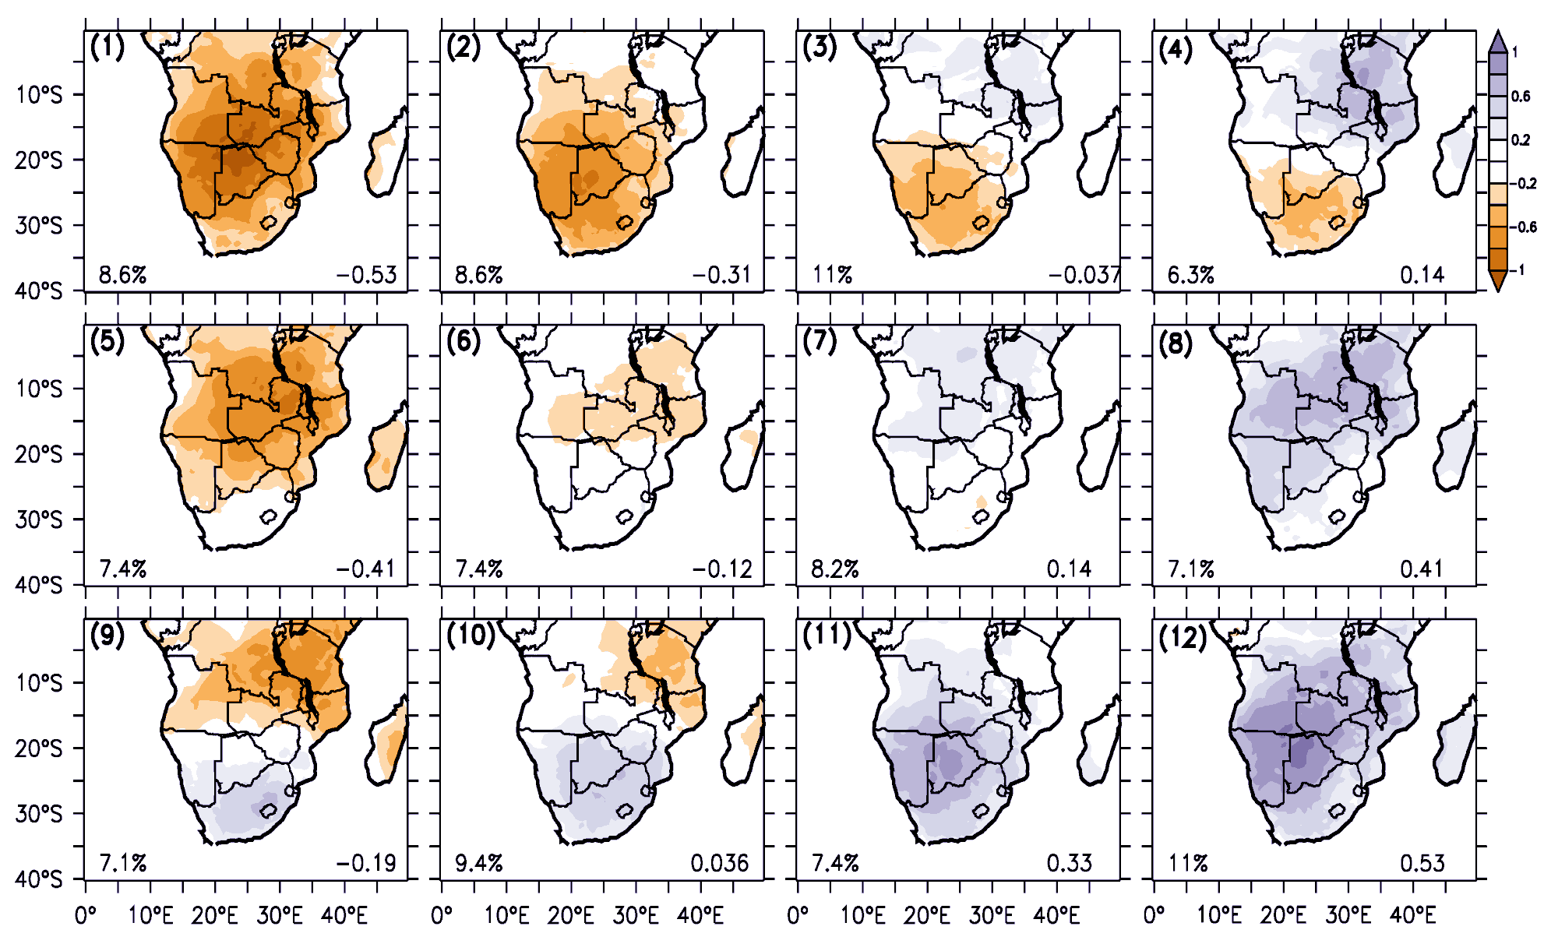

Drought patterns over Southern Africa
Notes:
These are 12 major types (or patterns) of regionally extensive droughts in southern Africa.
The colours show the values of a drought index (called Standardized Evapotranspiration Index). The index is calculated based on a balance between rainfall and potential evapotranspiration index. Hence, it account for the influence of global warming. In the figure, the negative values indicate dry condition (droughts), while the positive indicate wet conditions.
The four patterns at the edges show the extremes cases of drought patterns:
Top-left => The entire region is experiencing drought
Bottom-right => The entire region is experiencing wet condition
Top-left => The northern part is experiencing wet condition, while the southern part is experiencing drought.
Bottom-right => The northern part is experiencing drought, while the southern part is experiencing wet condition.

Slide 69
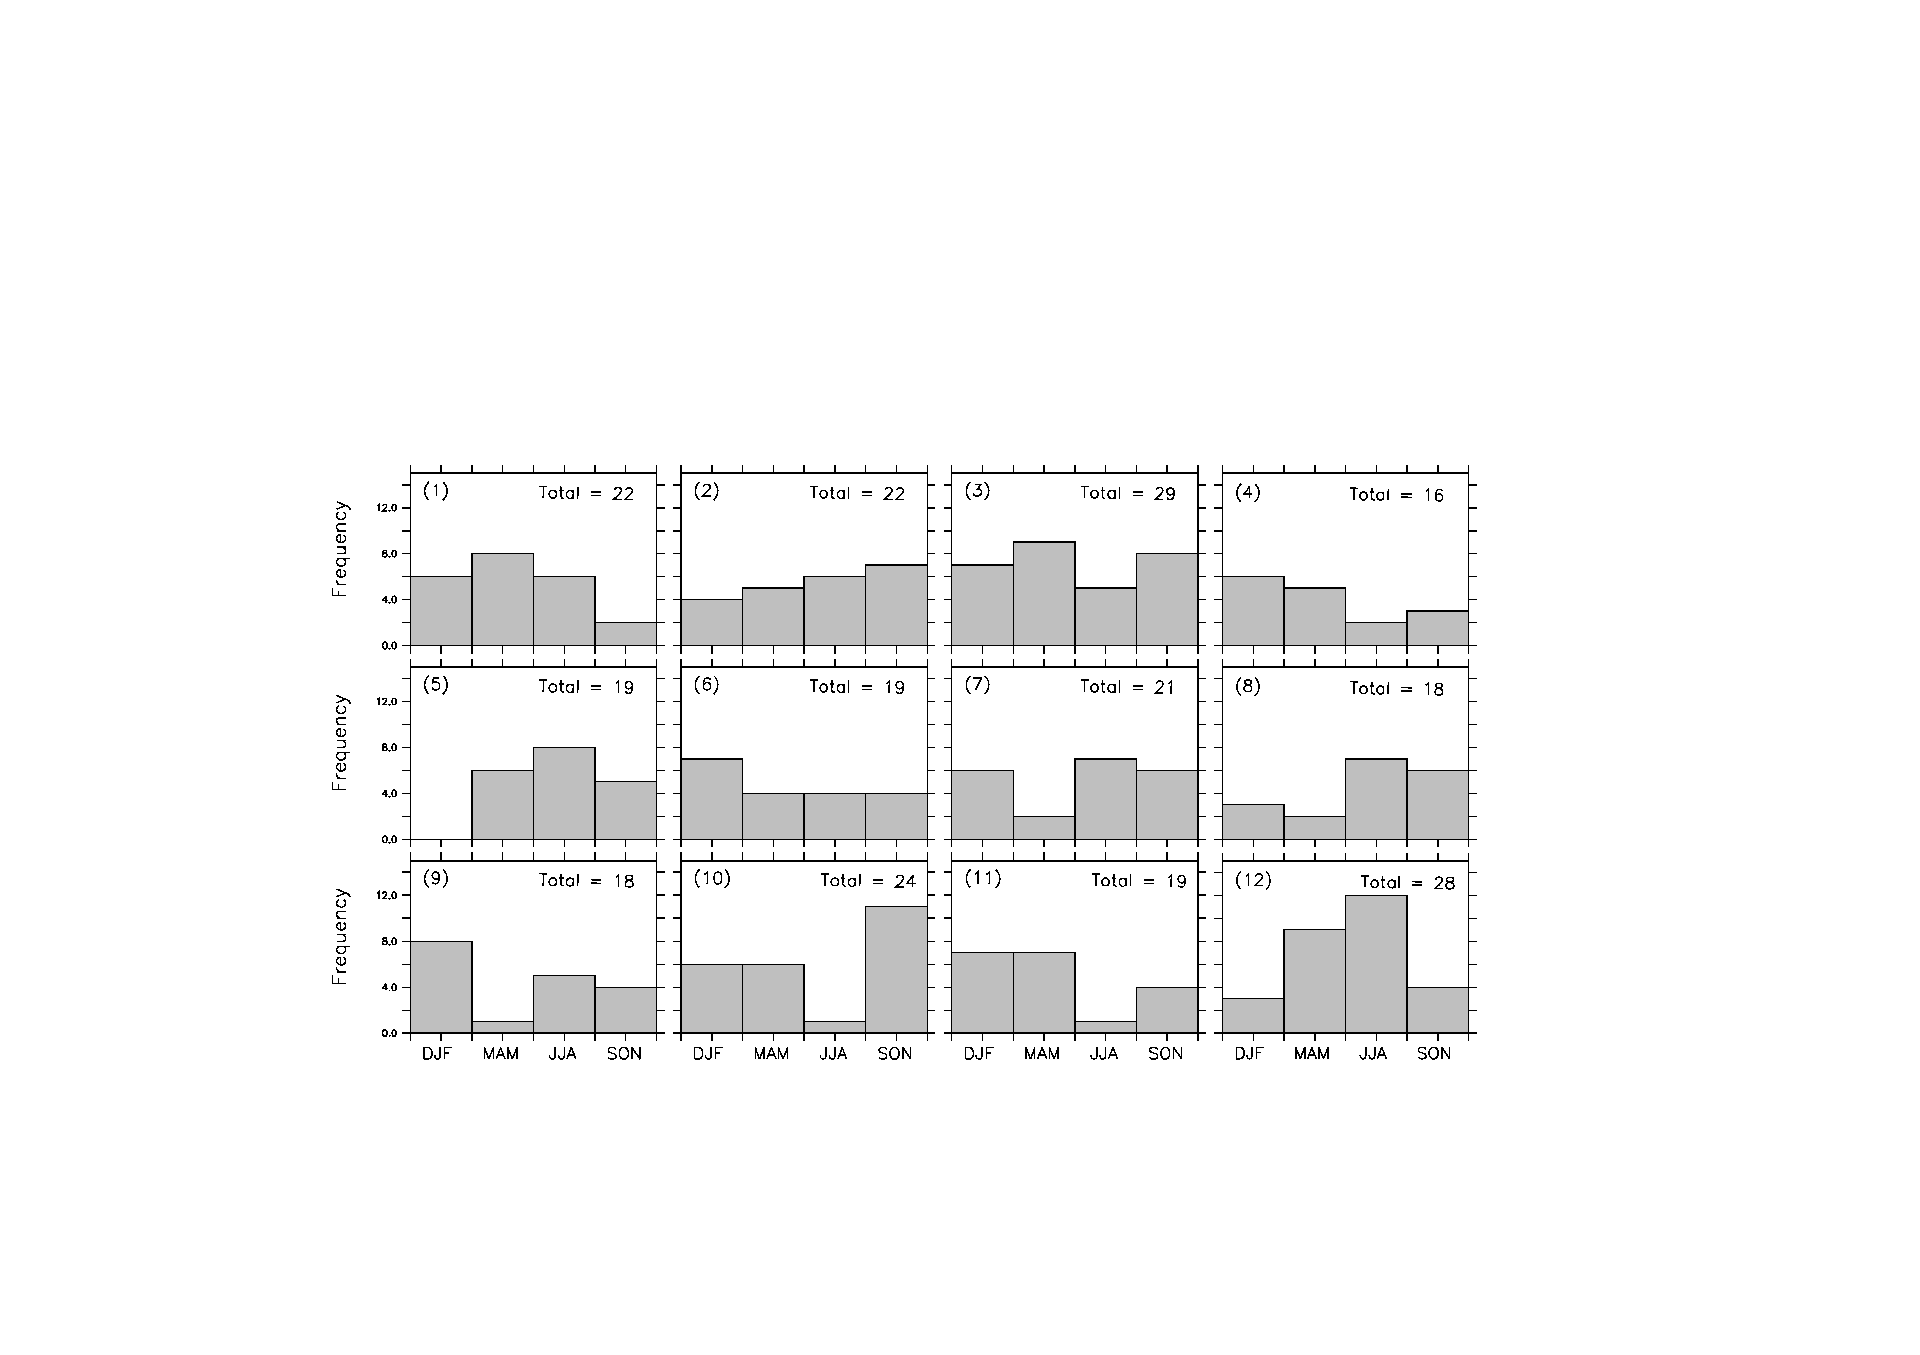
Seasonal variation of the drought patterns
Notes:
This slide presents the seasonal distribution of the drought patterns and it indicates the drought patterns can occur any season.

Slide 70
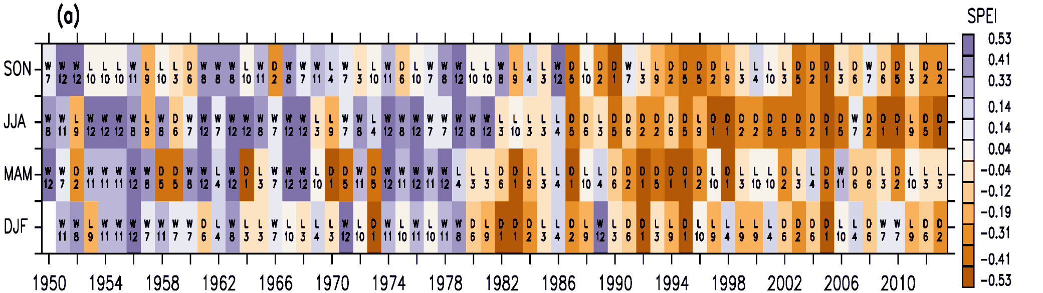
Transition and Persistence of the Drought Patterns
Notes:
The figure seasonal variation in the drought pattern in each year from 1950 – 2014). The colors indicate the average SPEI over Southern Africa. The number in each colour indicate the tag of the drought number (see slide 2).
It shows the while some drought pattern easily transit to other drought patterns, some can be persistent and linger for more than two seasons.

Slide 71
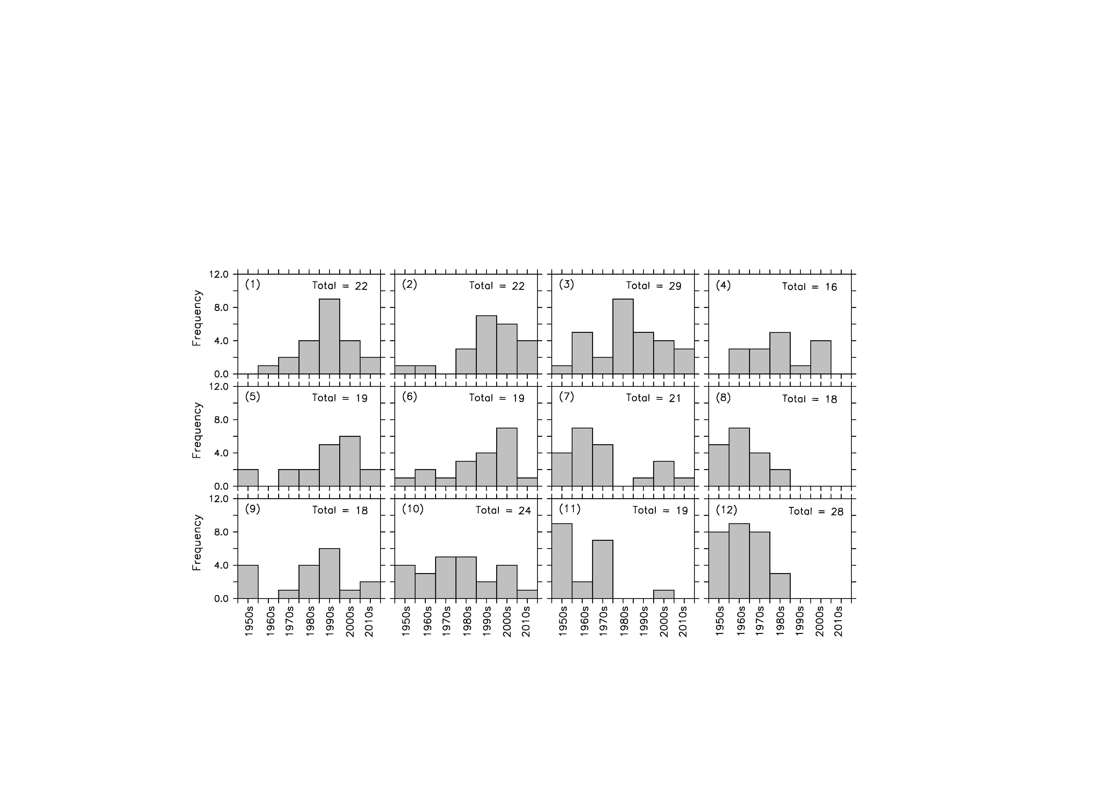
Decadal variation of the drought patterns
Notes:
This slide presents the decadal variation distribution of the drought patterns
It indicates that the bottom-right pattern (wet condition over the entire region) has not occurred since the last three decades.
There is a shift from wet condition to drying condition.. This may be due to climate change.

Slide 72
Seminar Topics
The usage of principal component analysis in climate science [Rebecca Efua Guisgo]
Application of Artificial Neural Network methods in climate science [Grace Adu Aborah]
A literature review on bias correction methods in climate science[Akeresola Rebecca]

Slide 73
Time Series Analysis

Slide 74
Time Series Analysis
Time series data:
sequence of measurements that follow non-random orders.
measurements are at equally spaced time intervals.
Goals of Time series analysis:
Identifying of patterns
Predicting future values

Slide 75
Identifying patterns…
Systematic pattern and random noise
Filtering …
Trend and Seasonality (periodicity)

Slide 76
Trend Analysis
Smoothing
local averaging of data
Curve fitting
Approximate data by a linear (non-linear) function

Slide 77
Analysis of seasonality
Autocorrelation
Autocorrelation
Cross - correlation
Fourier Analysis

Slide 78
Autocorrelation
When the correlation is calculated between a series and a lagged version of itself it is called autocorrelation.
A high correlation is likely to indicate a periodicity in the signal of the corresponding time duration.

Slide 79
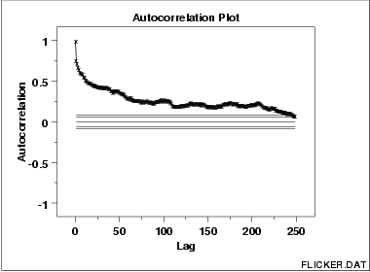
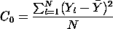
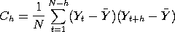
Autocorrelation (auto-correlogram)

Slide 80
Autocorrelation

Slide 81
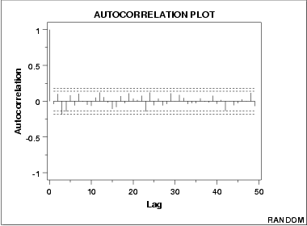
Autocorrelation Plot: Random (white noise)
There are no significant autocorrelations.
The data are random.

Slide 82
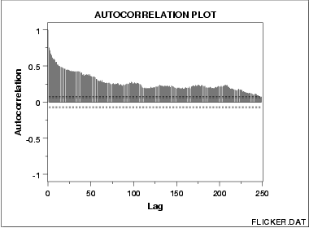
Autocorrelation Plot: Moderate Autocorrelation

Slide 83
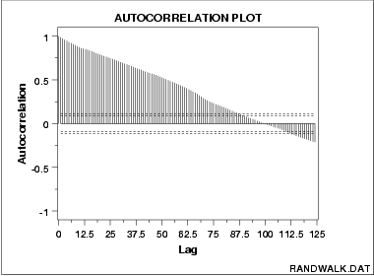
Autocorrelation Plot: Strong Autocorrelation

Slide 84
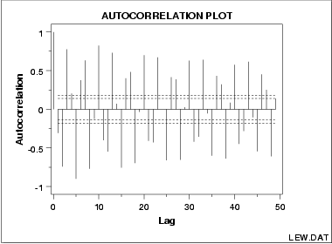
Autocorrelation Plot: Sinusoidal

Slide 85
Cross-correlation
Cross correlation is a standard method of estimating the degree to which two series are correlated.

Slide 86
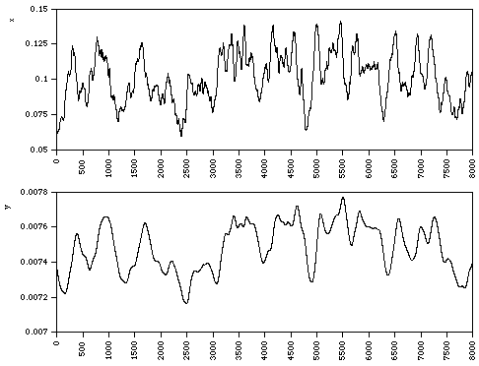
Cross-correlation: x and y

Slide 87
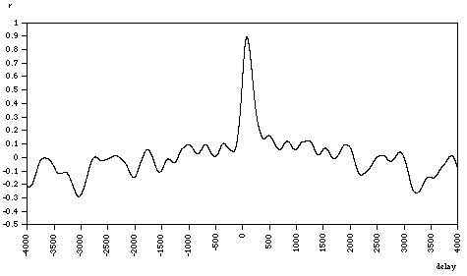
Cross-correlation Plot: r

Slide 88
Wavelet Analysis

Slide 89
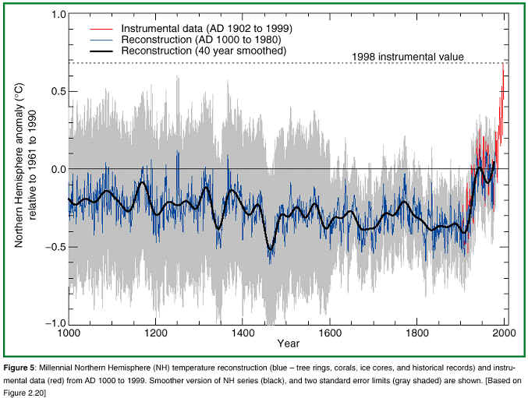
Past Climate Change: The last 1000 Years
Earth has always experienced climate variability on time scales ranging from seasonal-to-interannual to those occurring over hundreds to thousands of years.
Notice that for most of the last 1000 years, the climate has been cooler than normal.
The period from about 1550 - 1850 is referred to as the Little Ice Age.
Notice a dramatic increase in temperature since 1860

Slide 90
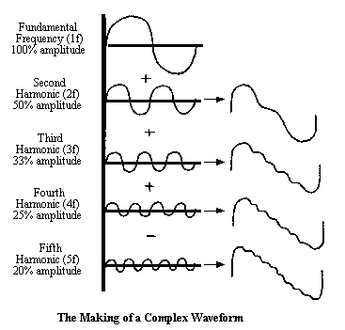
Trend and Variability

Slide 91
Fourier Analysis
Also known as spectral analysis
Use the exploration of cyclical patterns of data
Purpose:
to decompose a complex time series with cyclical components into a few underlying sinusoidal (sine and cosine) functions of particular wavelengths
to identify the seasonal fluctuations of different lengths
More efficient than autocorrelation
Uses variance (not correlation)

Slide 92
Basic Notations
Wave length
Amplitude
Frequency (f)
Period (1/f)
Harmonics (n*f)
Nyquist frequency (highest frequency)
Lowest frequency determined by n/2

Slide 93
Principle
Equation
x_{t} = a₀ + [a_{k}*cos(l_{k}*t) + b_{k}*sin(l_{k}*t)] (for k = 1 to q)
Periodogram / Power spectrum
P_{k} = (a_{k}² + b_{k}²) * N/2
Continuous spectrum / spectral density

Slide 94
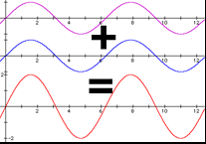
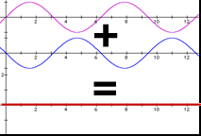
Fourier Analysis Example (1)

Slide 95
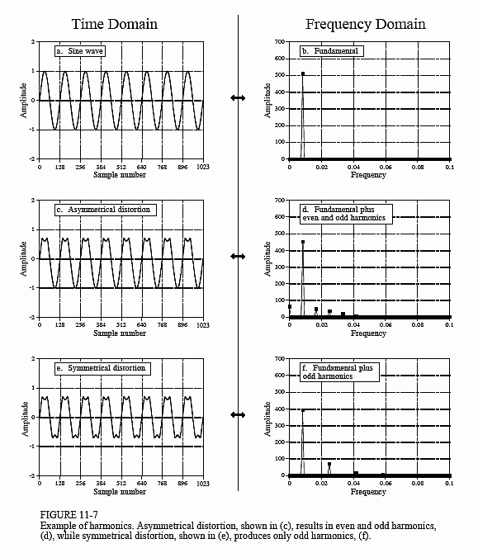
Fourier Analysis Example (2)

Slide 96
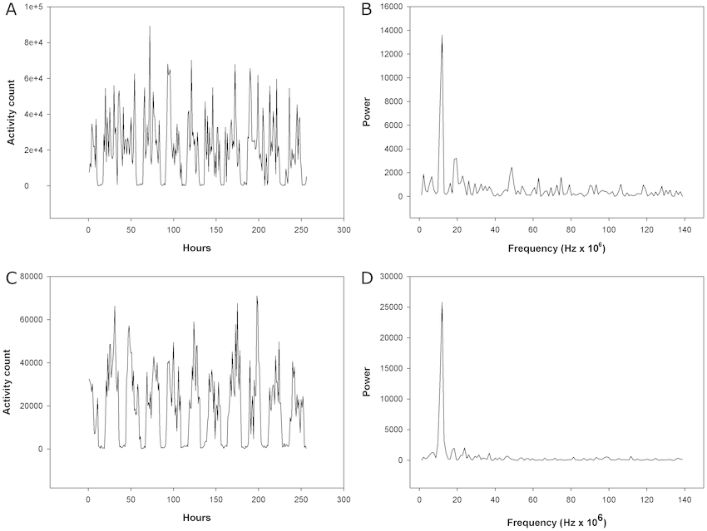
Real Example

Slide 97
Wavelet Analysis
http://paos.colorado.edu/research/wavelets/

Slide 98
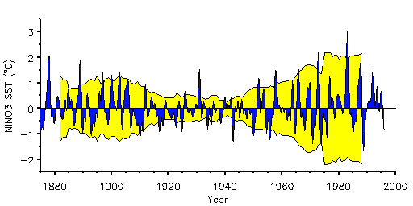
Data: NINO3 SST
Sea surface temperatures averaged over the NINO3 region with 15 years moving variance

Slide 99
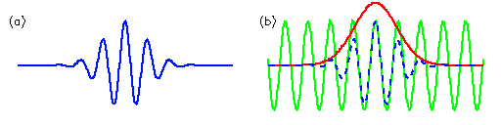
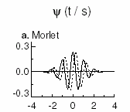
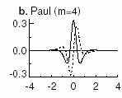
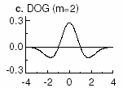
Morlet wavelet
Morlet wavelet of arbitrary width and amplitude

Slide 100
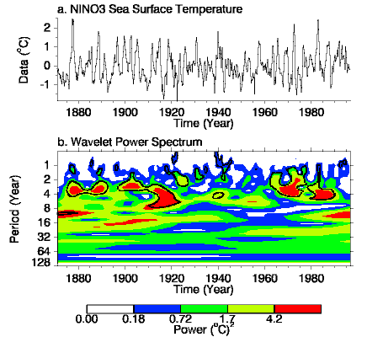
Waveleght analysis of NINO3 SST

Slide 101
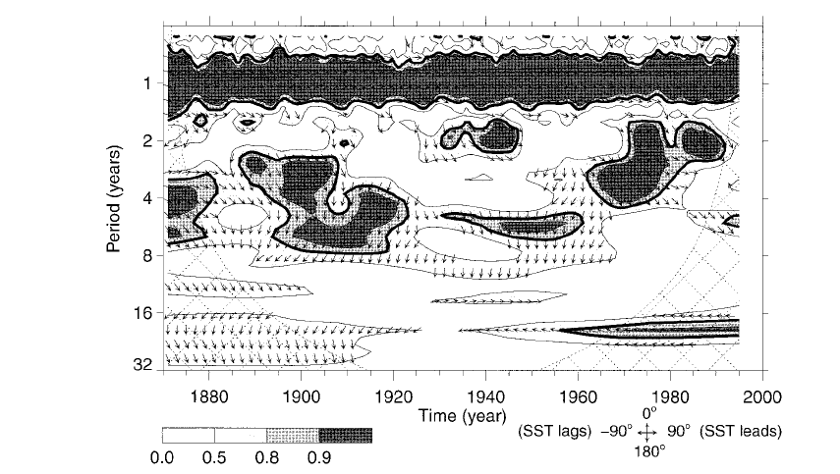
The wavelet coherency and phase between NNO3 and Indian Rainfall
The wavelet coherency and phase
Torreence at al 1999

Slide 102
Example from a student’s thesis (Ujeneza and Abiodun, 2014)

Slide 103
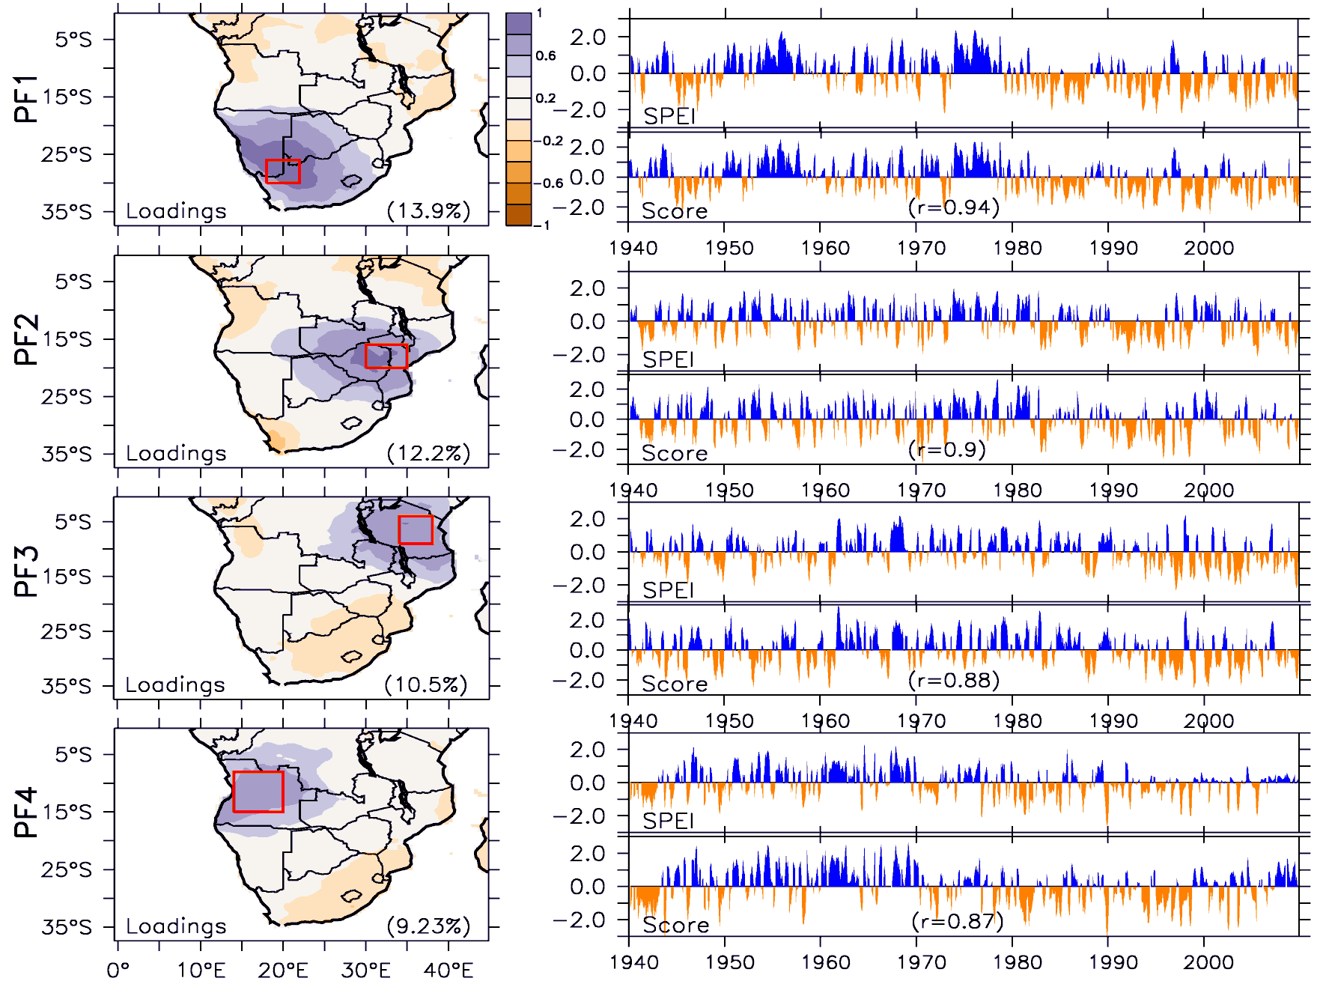
PCA of SPEI over South Africa

Slide 104
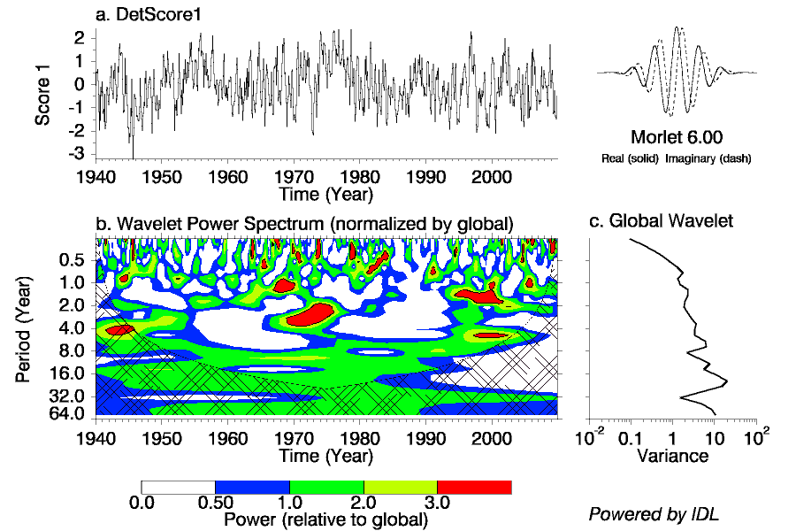



Wavelet Power Spectrum of the PFs
PF1
PF2
PF3
PF4

Slide 105

PFI and SOI
SOI: Southern Oscillation Index

Slide 106

PF2 and IOD
IOD: Indian Ocean Oscillation Dipole

Slide 107

PF3 and TSA
TSA: Tropical Southern Atlantic Oscilation

Slide 108

PF4 and AAO
AAO: North Atlantic Oscillation

